Slide 1


MS Excel

Slide 2
Contents
Introduction
Interface & Tools 3. Formatting
Formula & Calculations
SUM, AVERAGE, MAX, MIN
Percentage formula
IF Condition
Sorting
Filter
Charts

Slide 3
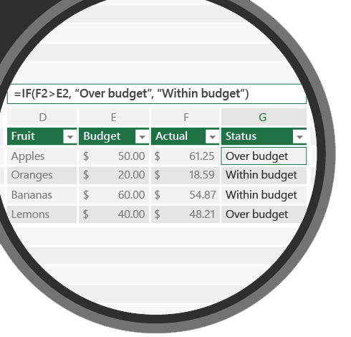

FILTER
6
Select specific records from entire table
Syntax
= > < >= <= AND OR

Slide 4
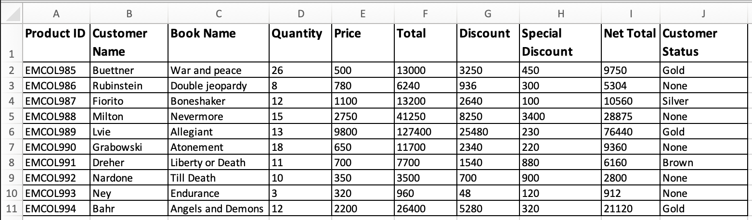
Filter
6.1
Selecting records

Slide 5
6.1 Question
Filter details customers name starting with letter “N”
Filter the details of customers those ordered more than 16 books
Filter customers those who got discount >= 8000 AND special discount > 1000
Filter customers those who purchased (Total) for more than 40,000 OR Net Total >= 20,000
Name starting with Letter “B” AND Total >= 10,000
Quantity less than 10 OR Customer status “None”
Book Name starting in letter “A” AND Discount > 20,000

Slide 6
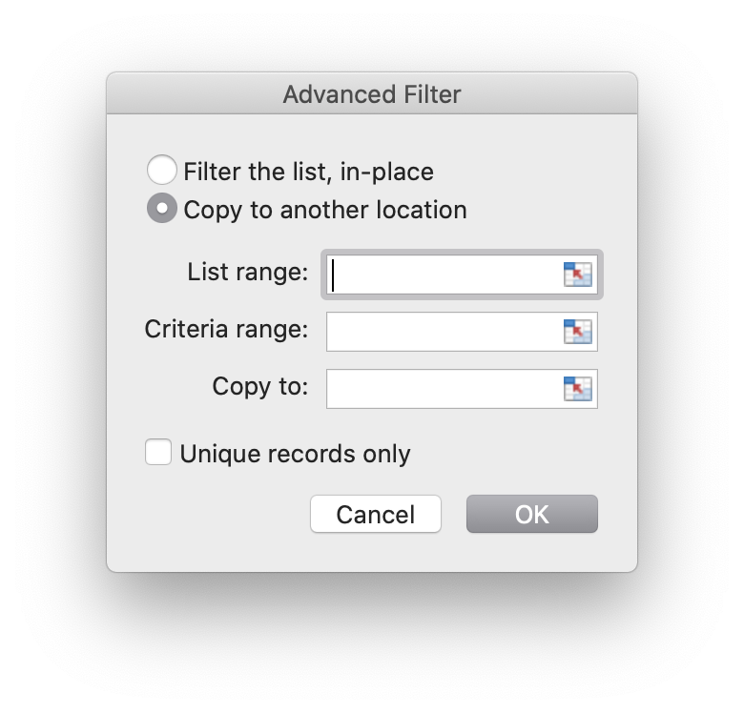
6.1.1 Polls
Q 6.1.1 Using which option we have to highlight entire table?
List range
Criteria range
Copy to

Slide 7
6.1.2 Polls
Q 6.1.2 Filter details of customer those who ordered more than 18 books
Figure 01.
Figure 02.
Figure 03.

Slide 8
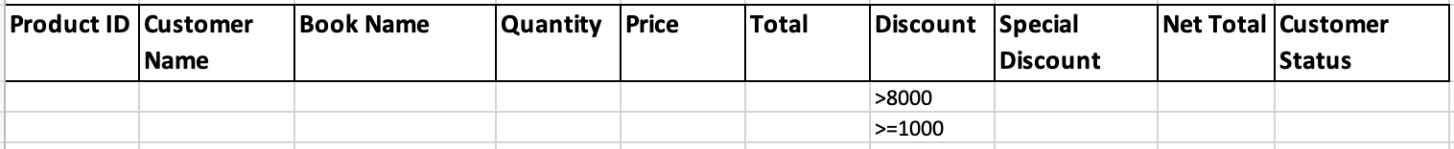
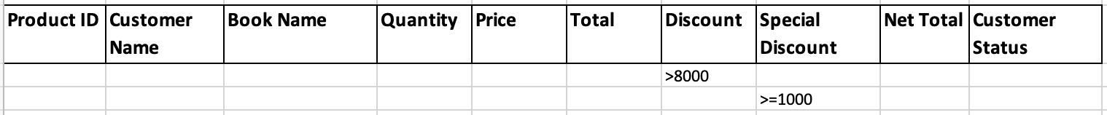
6.1.3 Polls
Q 6.1.3 Filter details of customer those got Discount more than 8000 OR Special Discount >= 1000
Figure 01.
Figure 02.
Figure 03.

Slide 9
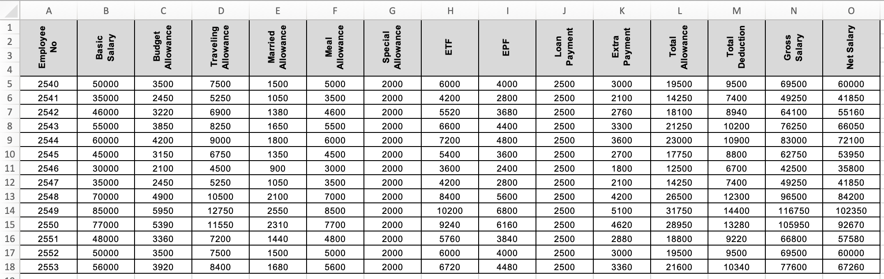
Filter
6.2
Selecting records

Slide 10
6.2 Question
Filter the details of employees those who got Basic Salary more than 75,000
Filter the details of employees those who got EPF more than equal to 5000 AND ETF more than 5000
Filter the details of employees who hold employee no “2548”
Filter the details of employees who got Loan payment
> 2000 OR Special Allowance >= 2000
Extra payment > 3000
Net Salary >= 80,000
Meal allowance >= 7500

Slide 11
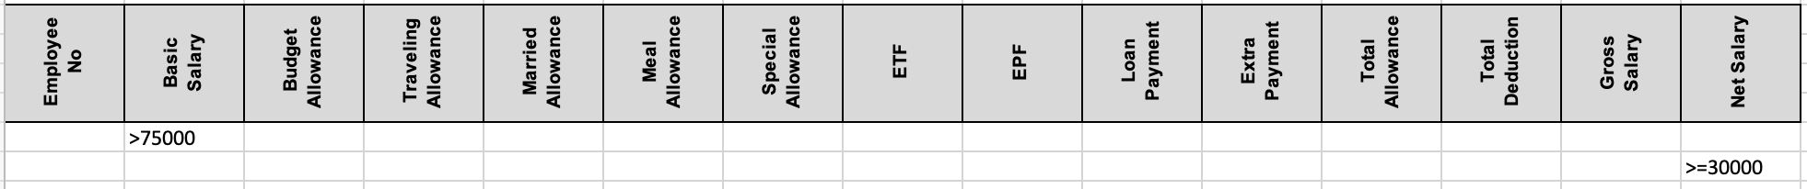
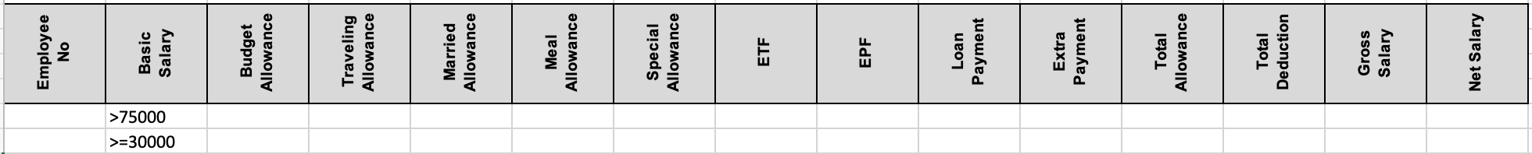
6.2.1 Polls
Q 6.2.1 Filter the details of employees those who got Basic Salary more than 75,000 AND Net Salary >= 30,000
Figure 01.
Figure 02.
Figure 03.

Slide 12
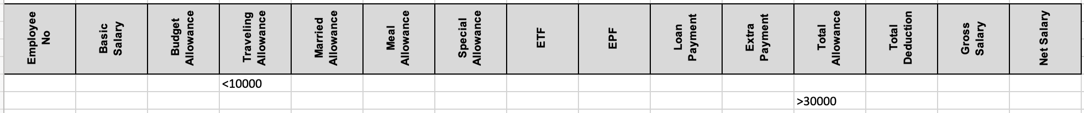
6.2.2 Polls
Q 6.2.2 Filter the details of employees those who got Travelling allowance < 10,000 AND Total Allowance more than 30,000
Figure 01.
Figure 02.
Figure 03.

Slide 13
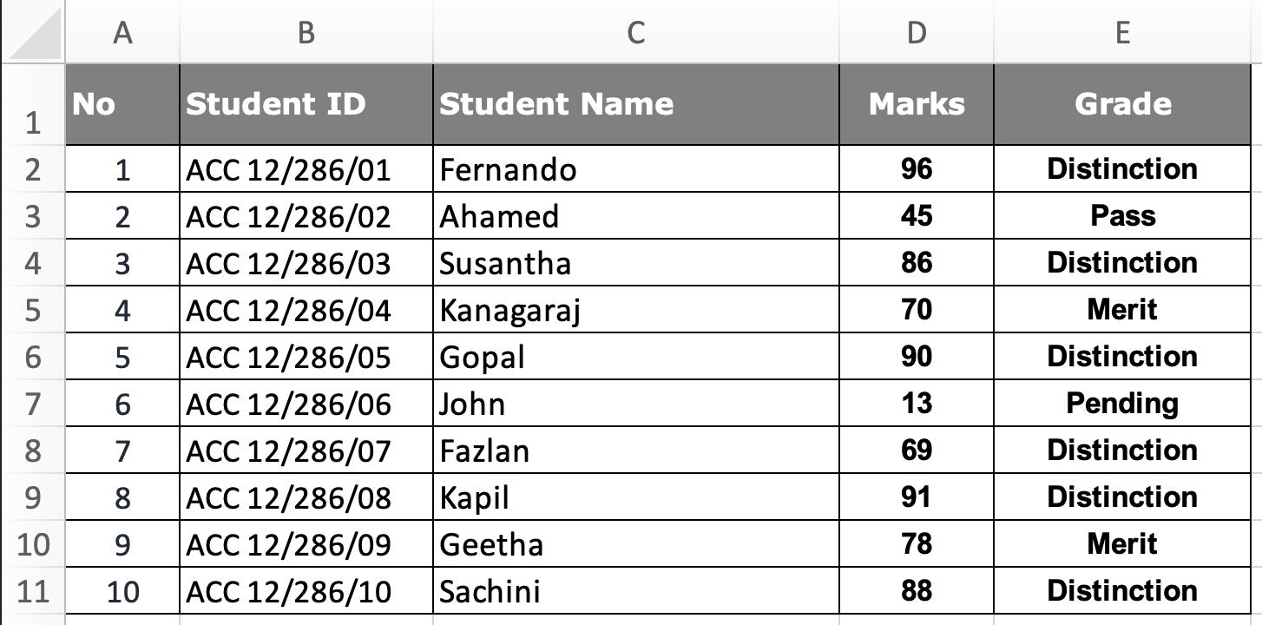
Filter
6.3
Selecting records

Slide 14
6.3 Question
Filter the students name starting in letter “S"
Filter students who scored Marks less than 40
Select the student those who got Distinction
Select the student no is equal to 8

Slide 15
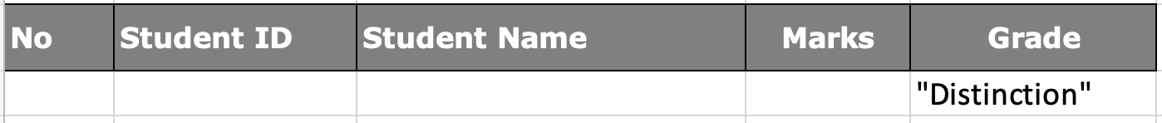
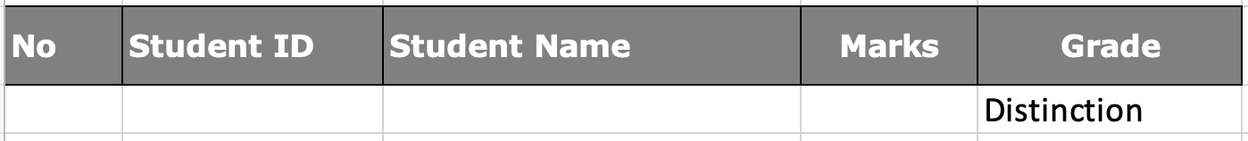
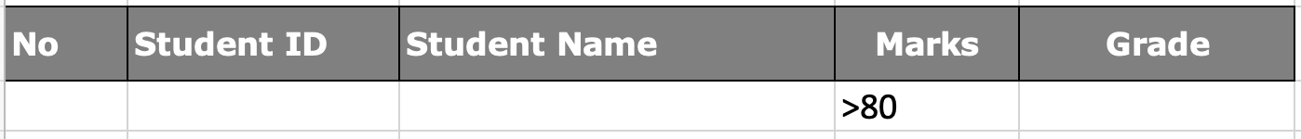
6.3.1 Polls
Q 6.3.1 Select the students those who got “Distinction” Figure 01.
Figure 02.
Figure 03.

Slide 16
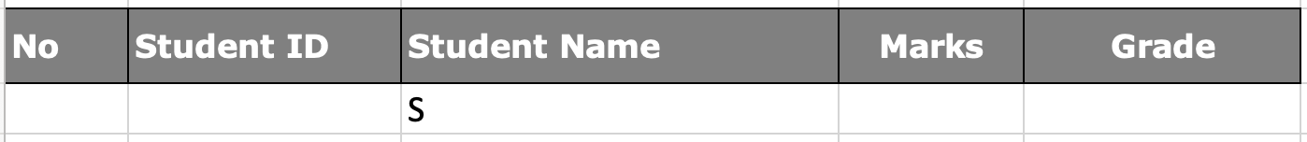
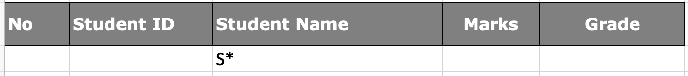
6.3.2 Polls
Q 6.3.2 Filter the student name starting in letter “S” Figure 01.
Figure 02.
Answer 03. Both Correct
*i If letter “i” contains anywhere in the selected column that will be selected

Slide 17
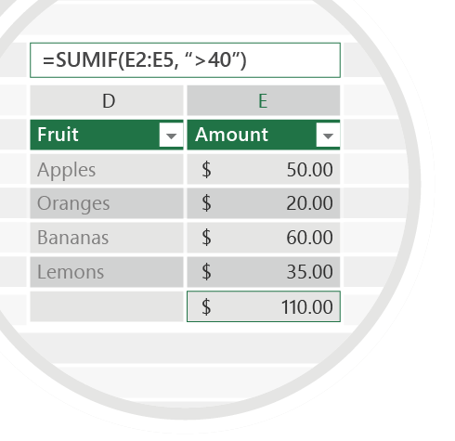



Exercise 6
Check your email for Question 6.1.pdf Question 6.2.pdf Question 6.3.pdf
Filter attached table according to given instructions in the slide
Emails
TO : shalomshan089@gmail.com

